Slide 1

Dr. Charles Severance, Sakai PMC Chair
Founder, Learning Experiences
drchuck@learnxp.com

Slide 2

Reliable Past – Predictable Future Built by educators for educators Market and Standards Leadership Privacy and Data Stewardship (*)

Slide 3


Held firmly to what we felt was right – LIKE A ROCK
Sticking with Sakai from 2006-2020 worked out very well
No need to rush from one LMS vendor to the next.
For profit vendors eventually sell their customers and their data to someone
WebCT - > Angel -> MoodleRooms -> Ultra?? -> Canvas -> Now what?
Slow steady growth and improvement
Faculty and students at Sakai schools give it very high marks
Notes:
Bob Seger – Like a rock - https://www.youtube.com/watch?v=fMIJuuk1SFs
Not a dime to space – but I was leaning – solid every where – like a rock
My hands were steady My eyes were clear and bright My walk had purpose My steps were quick and light And I held firmly To what I felt was right Like a rock

Slide 4
Winter, Spring, Summer, or Fall – YOU'VE GOT A FRIEND
Welcoming Community
Building Together, Learning Together, Teaching Together
You and your opinion matters
We don't hide behind sales, marketing and product managers
Sakai Camp
You can meet and talk with any member of the Sakai effort
Not a big party – a gathering of friends and colleagues
Boundaries are Porous – You Belong
Developer / IT staff / teacher / instruction design / support
Notes:
James taylor - https://www.youtube.com/watch?v=3WJ1cf3nrLE

Slide 5
Who Made Who? WHO TURNED THE SCREWS?
At the top or near the top of every evaluation where actual users of systems are doing the evaluation
Responsive design – 100% of functionality usable from handheld devices
Accessible – we strive for more than just getting certified
Lots of features – driven by learning needs – not product managers
Even with the "complexity" – very little training is required to use Sakai effectively
Notes:
James taylor - https://www.youtube.com/watch?v=3WJ1cf3nrLE

Slide 6
You are so BEAUTIFUL to me…
Hosting options
Low cost cloud providers – the majority of small and medium size schools
Hybrid cloud providers with local control of data
Locally owned cloud hardware
Behind a firewall – hyper sensitive about privacy
White label – of course
Open hosting
There are not "two versions" – each school has full access to all the recipes for building their own cloud-hosted instance
Notes:
James taylor - https://www.youtube.com/watch?v=3WJ1cf3nrLE

Slide 7


From small to large Sakai is a Better Experience

Slide 8
Small
Medium
Large
Max Privacy
Leader
Commercial cloud host
Attend SakaiCamp (1)
Attend Open Apereo (1)
Bring ideas
Support ideas with funds

Slide 9
Small
Medium
Large
Max Privacy
Leader
Commercial cloud host
Attend SakaiCamp (1)
Attend Open Apereo (2)
Bring ideas
Support ideas with funds

Slide 10
Small
Medium
Large
Max Privacy
Leader
Hybrid cloud host
Attend SakaiCamp (2)
Attend Open Apereo (3)
Design and fund new initiatives

Slide 11

Small
Medium
Large
Max Privacy
Leader
Production in your cloud
Attend SakaiCamp (3)
Attend Open Apereo (5)
Design and fund new initiatives

Slide 12
Small
Medium
Large
Max Privacy
Leader
Production in your cloud
Attend SakaiCamp (3)
Attend Open Apereo (5)
Design, develop, and lead new initiatives

Slide 13

Life in those other cloud LMSs Make your next LMS transition your last LMS transition
Cloud LMS, Inc.

Slide 14
Small
Medium
Large
Max Privacy
Leader
One cloud option
Attend conference (1)
Vote on ideas in a forum
Cloud LMS, Inc.

Slide 15
Small
Medium
Large
Max Privacy
Leader
One cloud option
Attend conference (3)
Vote on ideas in a forum
Cloud LMS, Inc.

Slide 16
Small
Medium
Large
Max Privacy
Leader
One cloud option
Attend conference (10)
Vote on ideas in a forum
Cloud LMS, Inc.

Slide 17
Small
Medium
Large
Max Privacy
Leader
Not Available
Vote on ideas in a forum
Cloud LMS, Inc.

Slide 18
Small
Medium
Large
Max Privacy
Leader
Not Available
Vote on ideas in a forum
Cloud LMS, Inc.

Slide 19
Do you like Piña Coladas? Let’s plan our escape…

Slide 20
What NOT to Do…
DO NOT start an LMS RFI / RFQ / Bakeoff / Committee (*)
If these are done fairly, these always conclude that the current LMS is the best choice
Or they limit input from a chosen few who are the advocates of the next shiny object
DO NOT scare your current LMS vendor
You have to pay them for three more years – minimum
They will be more cooperative in terms of giving you your data back if they see money for the next few years
(*) If you really want to do an LMS bakeoff – see one of Sakai's commercial partners

Slide 21
Don't Hire a LMS Switch Consultant…
You took my advice five years ago and that did not turn out as will as we had hoped because the vendor's direction / culture / priorities changed or they switched to a pure profit focus. There was no way anyone could have anticipated that!
Going forward, I will give you the exact same advice as I did five years with the vendor name changed – but this time it will work out – the new vendor's culture is great! All my research supports decision and everybody else is doing it!

Slide 22


Slide 23
Secret Plans – Year 1…
Purchase a small cloud-hosted plan from a Sakai cloud vendor
You can move to an owned cloud later – there is no rush
Plug Sakai into your current LMS as one or more LTI tools
Begin to quietly educate your campus about privacy
Let the faculty and students decide how much privacy their course needs
Let them choose Sakai course by course or school by school
Come to Open Apereo / SakaiCamp
Get to know us
Get your use cases (including transition needs) into our roadmap

Slide 24
Secret Plans – Year 2
Create an advisory group about LMS directions
Feedback from year 1 – what a great A/B test!
Evolve a campus learner data privacy strategy – thing outside the LMS
Experience a year of Sakai
Cloud hosted is super easy
Our product actually *changes* so upgrades are more than bug fixes
See how the roadmap (and your input) plays out in reality
Keep your cloud LMS vendor very happy
Go to their conference and compare the actual experience to Sakai

Slide 25
Secret Plans – Year 3
Evolve your hosting to hybrid
Own your learner's data but continue to outsource server / software
Talk to your LTI vendors
Come up with a list of the worst data offenders and tell your campus they will be gone in a year unless they improve privacy to meet your new campus privacy policies
Talk to Your Cloud LMS vendor
Show them how learners, teachers and schools are starting to "prefer privacy"
Ask them what their plans are to address privacy / long term data retention issues

Slide 26
Secret Plan Summary
In IT if you have a three year plan, call it good – things change
If campuses commit to a move towards protecting learner data privacy, some vendors will begin to react
Learning Tools Interoperability (LTI) was a fringe idea in 2007 and became mainstream by 2010
Aggressively protecting learner data privacy is the most important issue for the next decade in educational technology

Slide 27
So let’s get started!

Slide 28
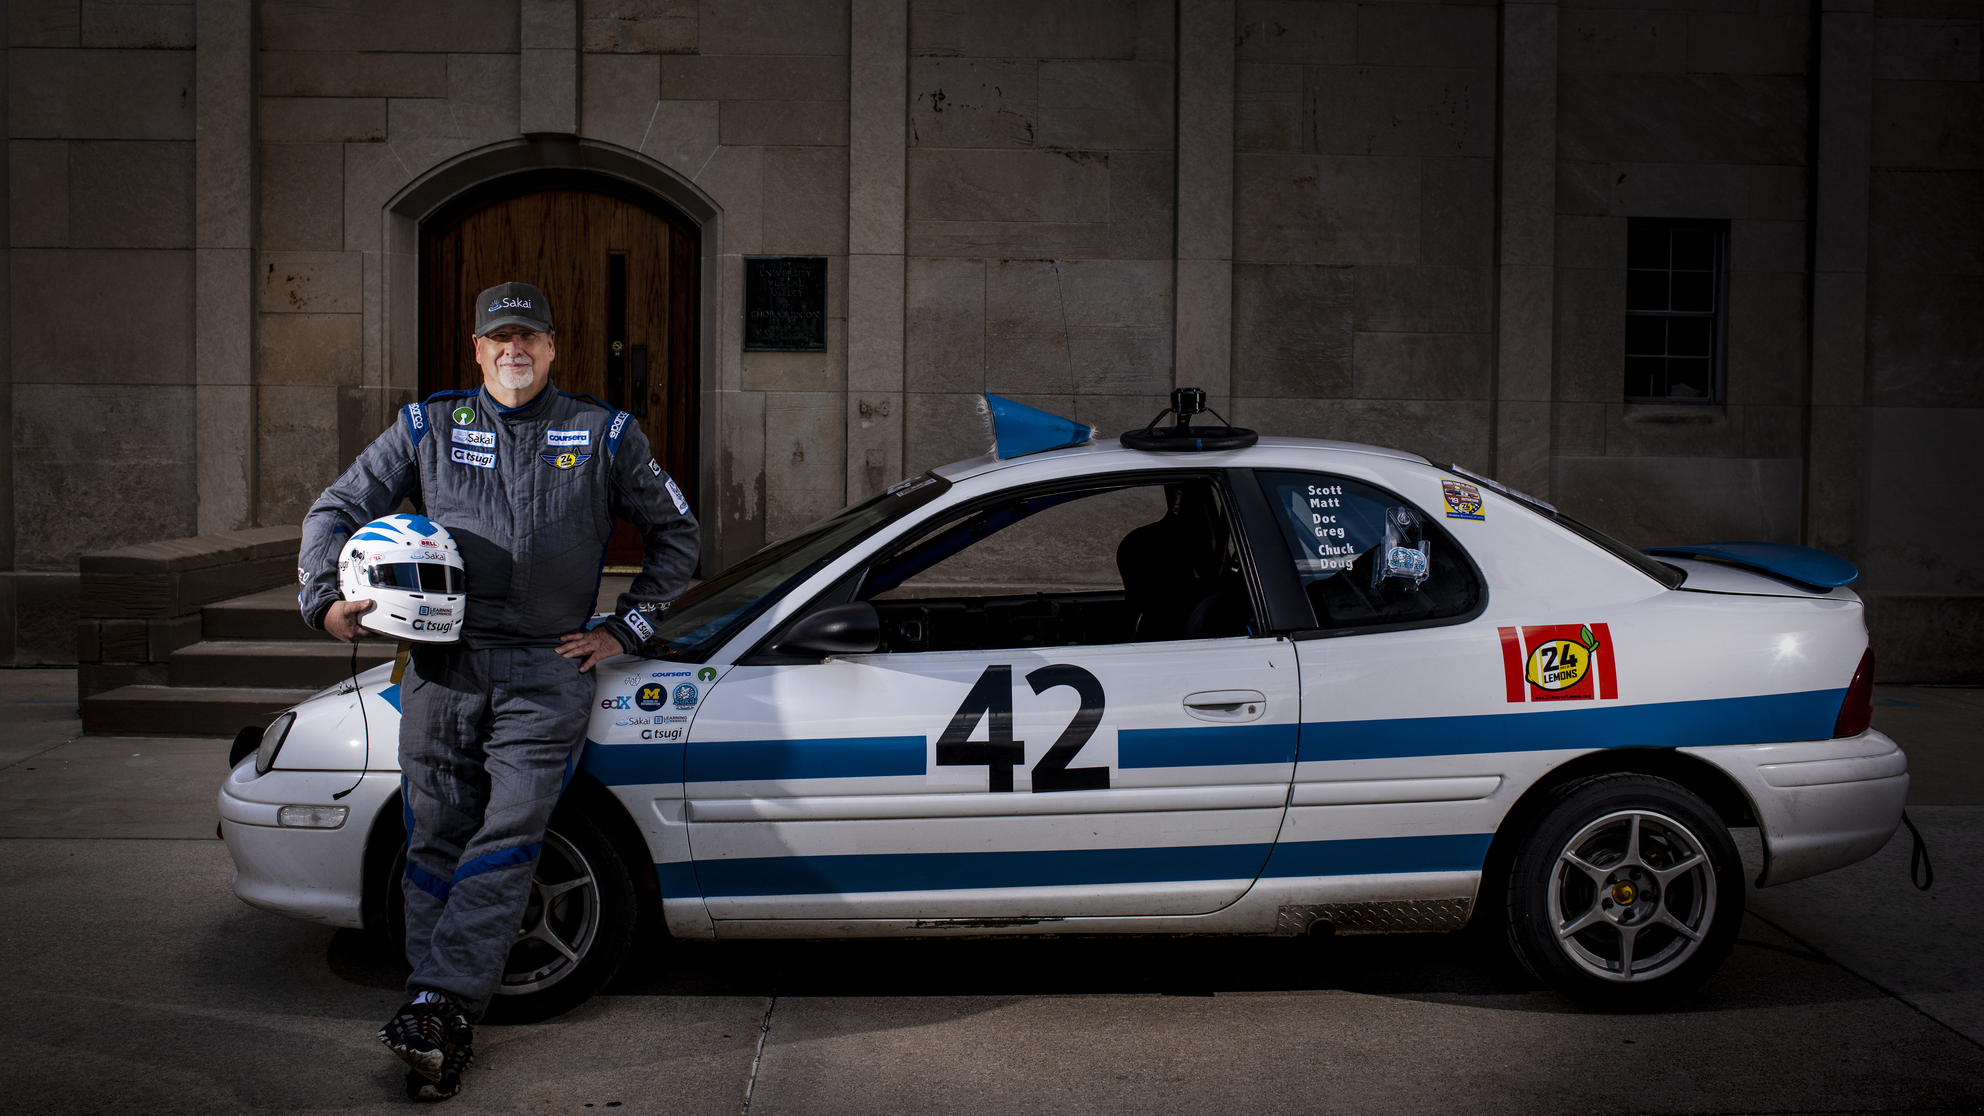
Privacy for Everybody
Charles R. Severance
www.sakailms.org
Photo: Jeffrey Smith

